Slide 1
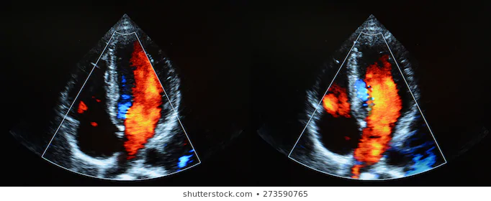
Assessment of the Diastolic Functions of the Heart in Patients with Cerebrovascular Disease
Talha Erdoğan¹, Mahmut Uluganyan²
¹Bezmialem Vakıf University Faculty of Medicine, Istanbul, Turkey
²Bezmialem Vakıf University, Faculty of Medicine, Department of Cardiology, Istanbul,Turkey
Introduction
Results
Cerebrovascular diseases are a leading cause morbidity and mortality. There are various risk factors which included hypertension (HT), diabetes mellitus (DM), smoking, dyslipidemia, atrial fibrillation (AF), carotid artery stenosis and obesity. Cardiovascular diseases have an important place in cerebrovascular diseases. The term diastolic dysfunction is used for conditions in which diastolic relaxation, diastolic tension and left ventricular filling are impaired. In this study, we evaluate the diastolic parameters of the heart in patients with cerebrovascular disease.
In this study, diastolic functions of 92 patients with CVD [59 men (64,1%), 33 women (35,9%)] were evaluated 80 patients (87%) were stage 1, 8 patients were stage 2 (%8,7), 4 patients were evaluated as normal (4,3%). It was observed that diastolic parameters deteriorated more compared to the normal population
Conclusion
The analysis of the enrolled patients showed that the diatolic parameters of the patients with cerebrovascular disease is more deteriorated than normal population.
Materials and Methods
This study was performed retrospectively. It was planned to enroll 150 patients who were diagnosed with acute CVD and underwent echocardiographic examination. The study was conducted in patients diagnosed with CVD at Bezmialem Vakıf University Hospital between November 2019 and December 2020.
Patients who were diagnosed with cerebro vascular disease and had an echocardiographic examination at bedtime were included in the study from hospital records.
The diastolic function evaluations of the patients were evaluated by measuring the tissue velocities (e'/a') and E/e' rates with transmitral filling (E/A) and tissue Doppler. In addition to the diastolic parameters of the patients, left ventricular ejection fractions were also evaluated.
Key Words
Cerebrovascular Disease, Cardivascular Disease, Diastolic Disfunction
References
1.Special report from the National Institute of Neurological Disorders and Stroke. Classification of cerebrovascular diseases III. Stroke 1990; 21:637-676. DOI: 10.1161/01.STR.21.4.637
2. Sahin AD, Ustu Y, Isık D, Oztas D, Eray IK, Ugurlu M. Serebrovasküler Hastalık Geçiren Hastaların Demografik Özellikleri ve Birinci Basamak Sağlık Merkezlerinde Önlenebilir Risk Faktörlerinin Değerlendirilmesi. Ankara Med J, 2015, 15(4):196-208. DOI: 10.17098/amj.79435
3.Park HK, Kim BJ, Yoon CH, Yang MH, Han MK, Bae HJ. Left Ventricular Diastolic Dysfunction in Ischemic Stroke: Functional and Vascular Outcomes. J Stroke. 2016;18(2):195–202. doi:10.5853/jos.2015.01697
4. Seo JK, Lee KB, Lee JG, Kim JS, Roh H, Ahn MY, Park BW, Hyon MS. Implication of Left Ventricular Diastolic Dysfunction in Cryptogenic Ischemic Stroke. Stroke. 2014;45:2757–2761. DOI: 10.1161/STROKEAHA.114.006108
5. Korkut B, Küçük AK, Gök H, Telli HH. Kalbin Diyastolik Disfonksiyonu. Türkiye Klinikleri J Med Sci. 1996;16:285-291

